Slide 1
Southport and Ormskirk Hospitals
Library & Knowledge Services
Welcome

Slide 2
THE LIBRARIES
There is a Library on each hospital site
Hanley Library
Sanderson Library
Clinical Education Centre
Southport Hospital
Town Lane
Southport
PR8 6PN
Education Centre
Ormskirk Hospital
Wigan Road
Ormskirk
L39 2AZ
Monday - Friday
8.30am - 4.30pm
Fully staffed
Monday - Friday
8.30am - 4.30pm
Self-Service
24-hour access is available if you are a member of the Library

Slide 3
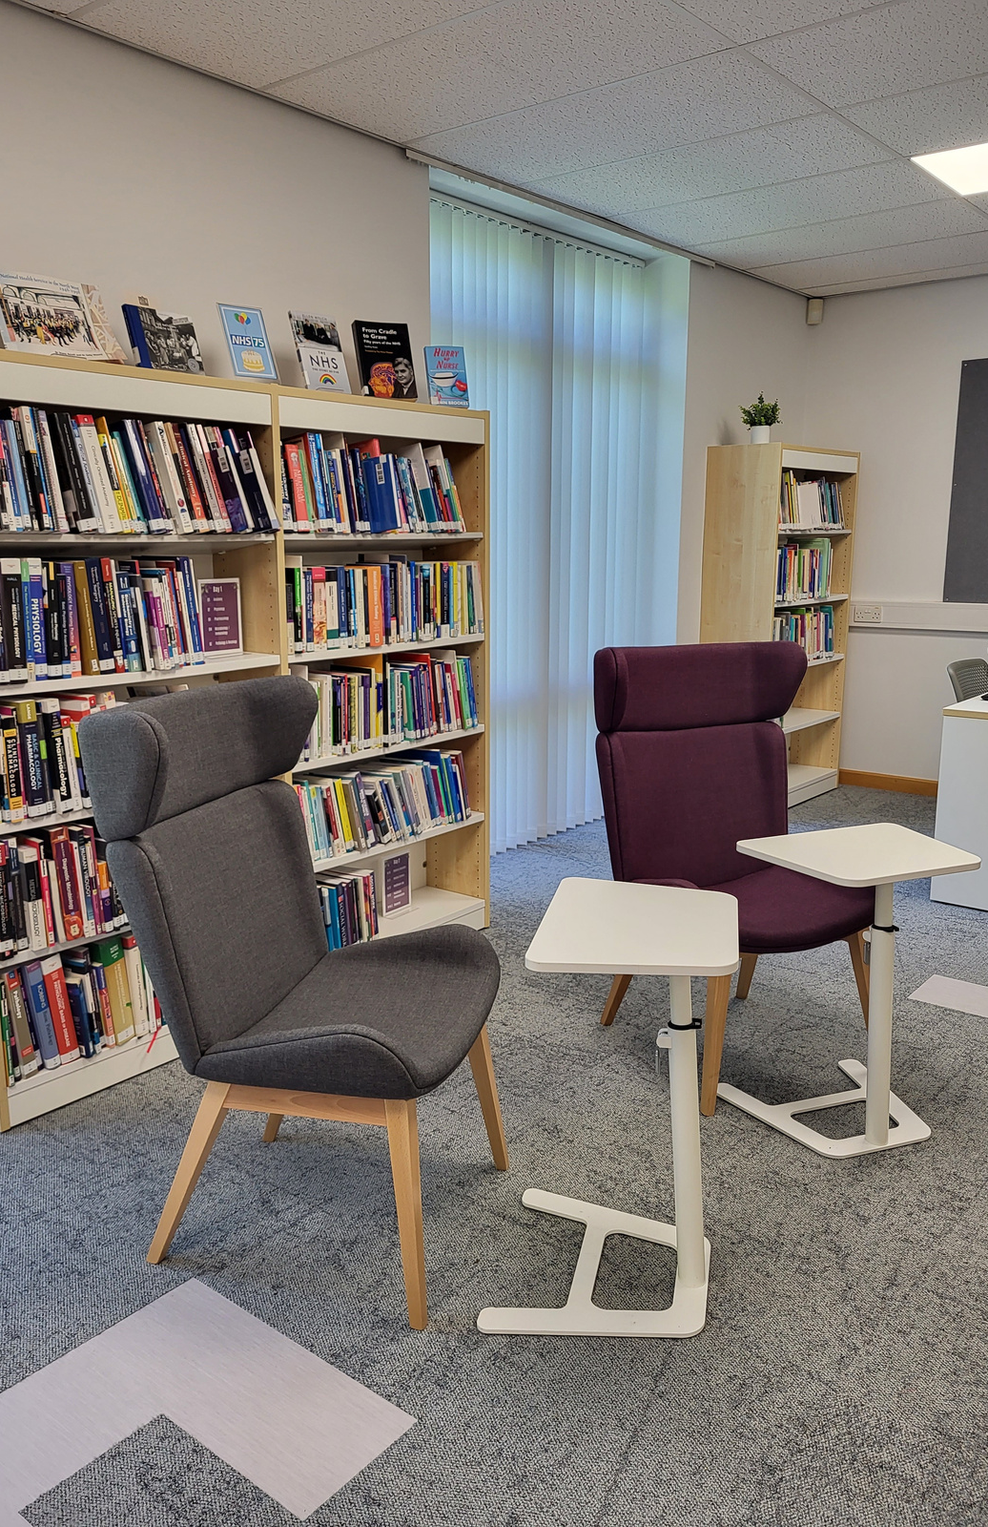
JOINING THE LIBRARY
Becoming a member allows you to use and borrow from both the Hanley Library and the Sanderson Library, as well as from other NHS Libraries in the NW
Library membership is FREE and available to anyone working for, or on placement at, Mersey & West Lancs Teaching Hospitals NHS Trust
It also allows you to access a world of electronic clinical and non-clinical information
Members can borrow up to 12 books at any time
You can renew your books up to a maximum of 4 times
Collect and complete a membership form at either Library or scan the QR Code here to fill out an online form

Slide 4
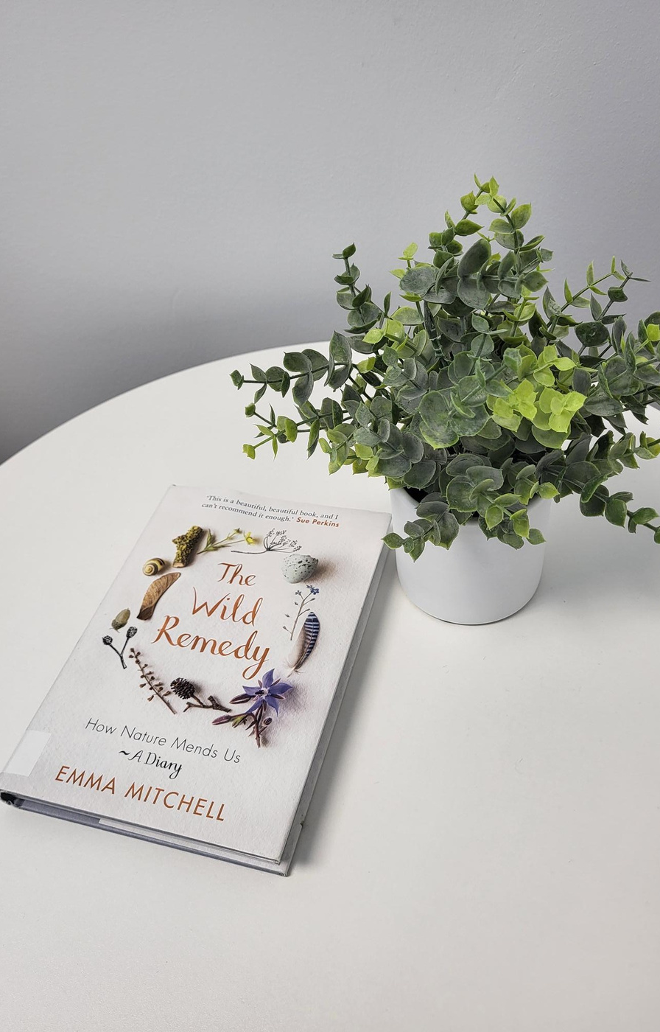
YOUR LIBRARY
A bright and welcoming space
PCs and laptops
Space to work
3 individual soundproofed Study Pods*
Large selection of books and other resources
A Wellbeing Room*
Professional and knowledgeable staff support

Slide 5
BOOKS & EBOOKS
We currently hold over 3000 books in stock, over both sites
You can also borrow any titles you need from other NHS Libraries in the NoW consortium
In addition, we have thousands more available as eBooks
To access the Library catalogue, click on the SEARCH BOOKS & EBOOKS link on the Library webpage
Or scan the QR code for access

Slide 6
NHS ATHENS ACCOUNT
You will need an NHS Athens Account to access any of our electronic resources
You will automatically receive an Athens login when you join the library
If you are unsure if you may already have an Athens account, please contact the Library for help

Slide 7
THE KNOWLEDGE & LIBRARY HUB
This is a single national gateway for all staff and learners in the NHS in England
It brings together ebooks, journal articles and much more into a single search
The Library offers training on using the Hub
It’s a great place to begin!
To access the Hub click on the link on the Library webpage
Please contact us for help
Or scan the QR code for access

Slide 8
HEALTHCARE DATABASES
The Library provides access to a host of key healthcare databases, from a variety of providers
Medline
CINAHL
Embase
AMED
PsychInfo
BNI
Cochrane Library
HMIC
To access the databases, click on the SEARCH HEALTHCARE DATABASES link on the Library webpage
Or scan here for access
Citations, Abstracts and Full-Text articles are available

Slide 9
MORE ONLINE RESOURCES
As well as databases, we offer a large selection of other online resources including...
DynaMed
Dynamic Health
BMJ Best Practice
BNF
Anatomy TV
The Royal Marsden Procedures
You will need your NHS Athens account to access all online resources
and more

Slide 10
LITERATURE SEARCHING SERVICE
Let us save you time and effort!
We can conduct literature reviews for you on any subject
We will search the available literature and compile a bibliography of sources for you
Simply complete a request form online or contact the Library to discuss your requirements
Or scan the QR code for a form

Slide 11
INFORMATION SKILLS TRAINING
The Library can offer training in finding and interpreting evidence-based information
Sessions include:
Effective Literature Searching
Finding the Best Evidence
Introduction to Point-of-Care Tools
Reference Writing & Other Study Skills
Scan here or contact the Library to book a session today!
Training sessions are available in timetabled sessions, as one-to-one sessions or as bespoke group sessions to departments and teams

Slide 12
ALERTS
We can set up free, tailored current awareness alerts so you can get the latest information in your area of interest - straight to your inbox!
Contact the Library to discuss

Slide 13
THE STAFF
Our professional, knowledgeable and friendly staff are here to help
Margaret-Mary O'Mahony
Stephanie Burns
Saffron Webb
margaret.omahony2
@merseywestlancs.nhs.uk
stephanie.burns
@merseywestlancs.nhs.uk
saffron.webb2
@merseywestlancs.nhs.uk

Slide 14
SOCIAL MEDIA
You can keep up to date with all things Library by following us on social media

Slide 15
CONTACT US
If you have any questions or need any help or advice, please contact the Library Team
soh-tr.hanleylibrary
@merseywestlancs.nhs.uk
01704 704202

